Slide 2
校園故事
緊急
WARNING

Slide 3
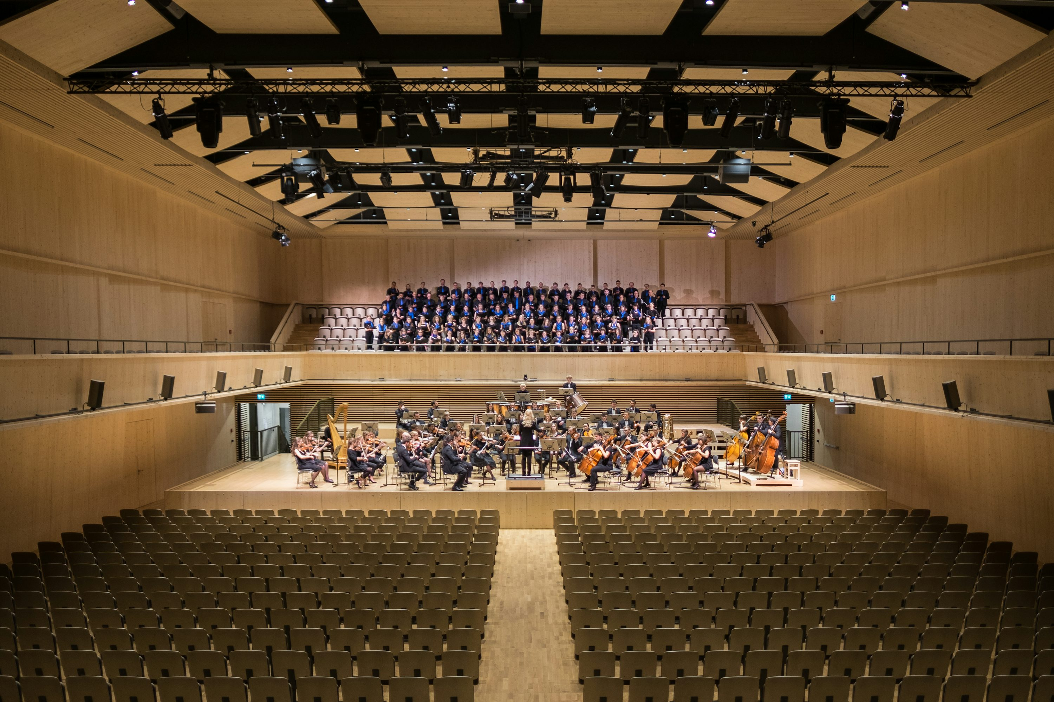
1.目標
ATTENTION
Notes:
https://unsplash.com/photos/group-of-people-in-theater-_r0fD1pDQ38

Slide 4

2.阻礙
ATTENTION
Notes:
https://unsplash.com/photos/a-group-of-people-sitting-at-a-table-with-notebooks-and-pens-YyzzcE13TKQ

Slide 5
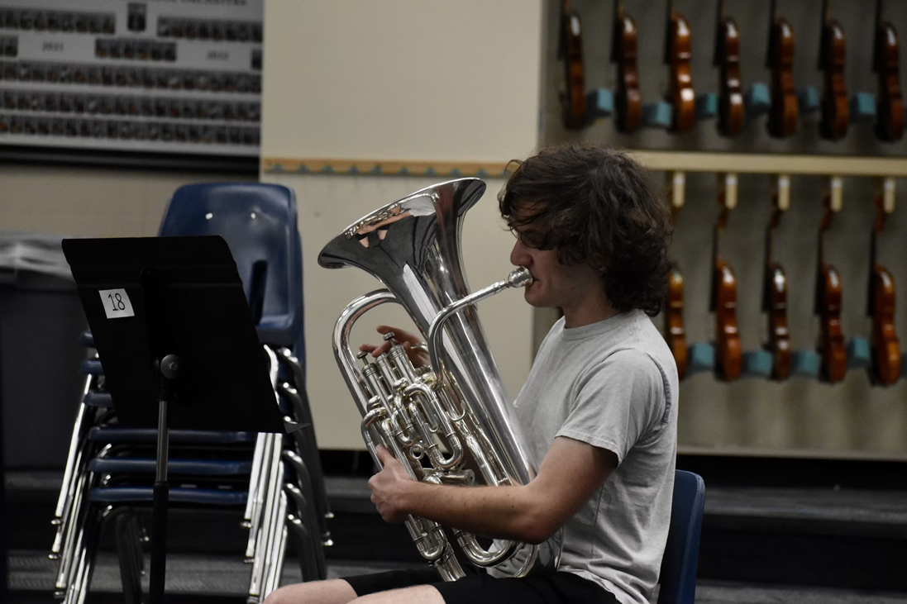
3.努力
ATTENTION
Notes:
https://unsplash.com/photos/a-man-sitting-down-playing-a-trumpet-ydFXtCrQifw

Slide 6
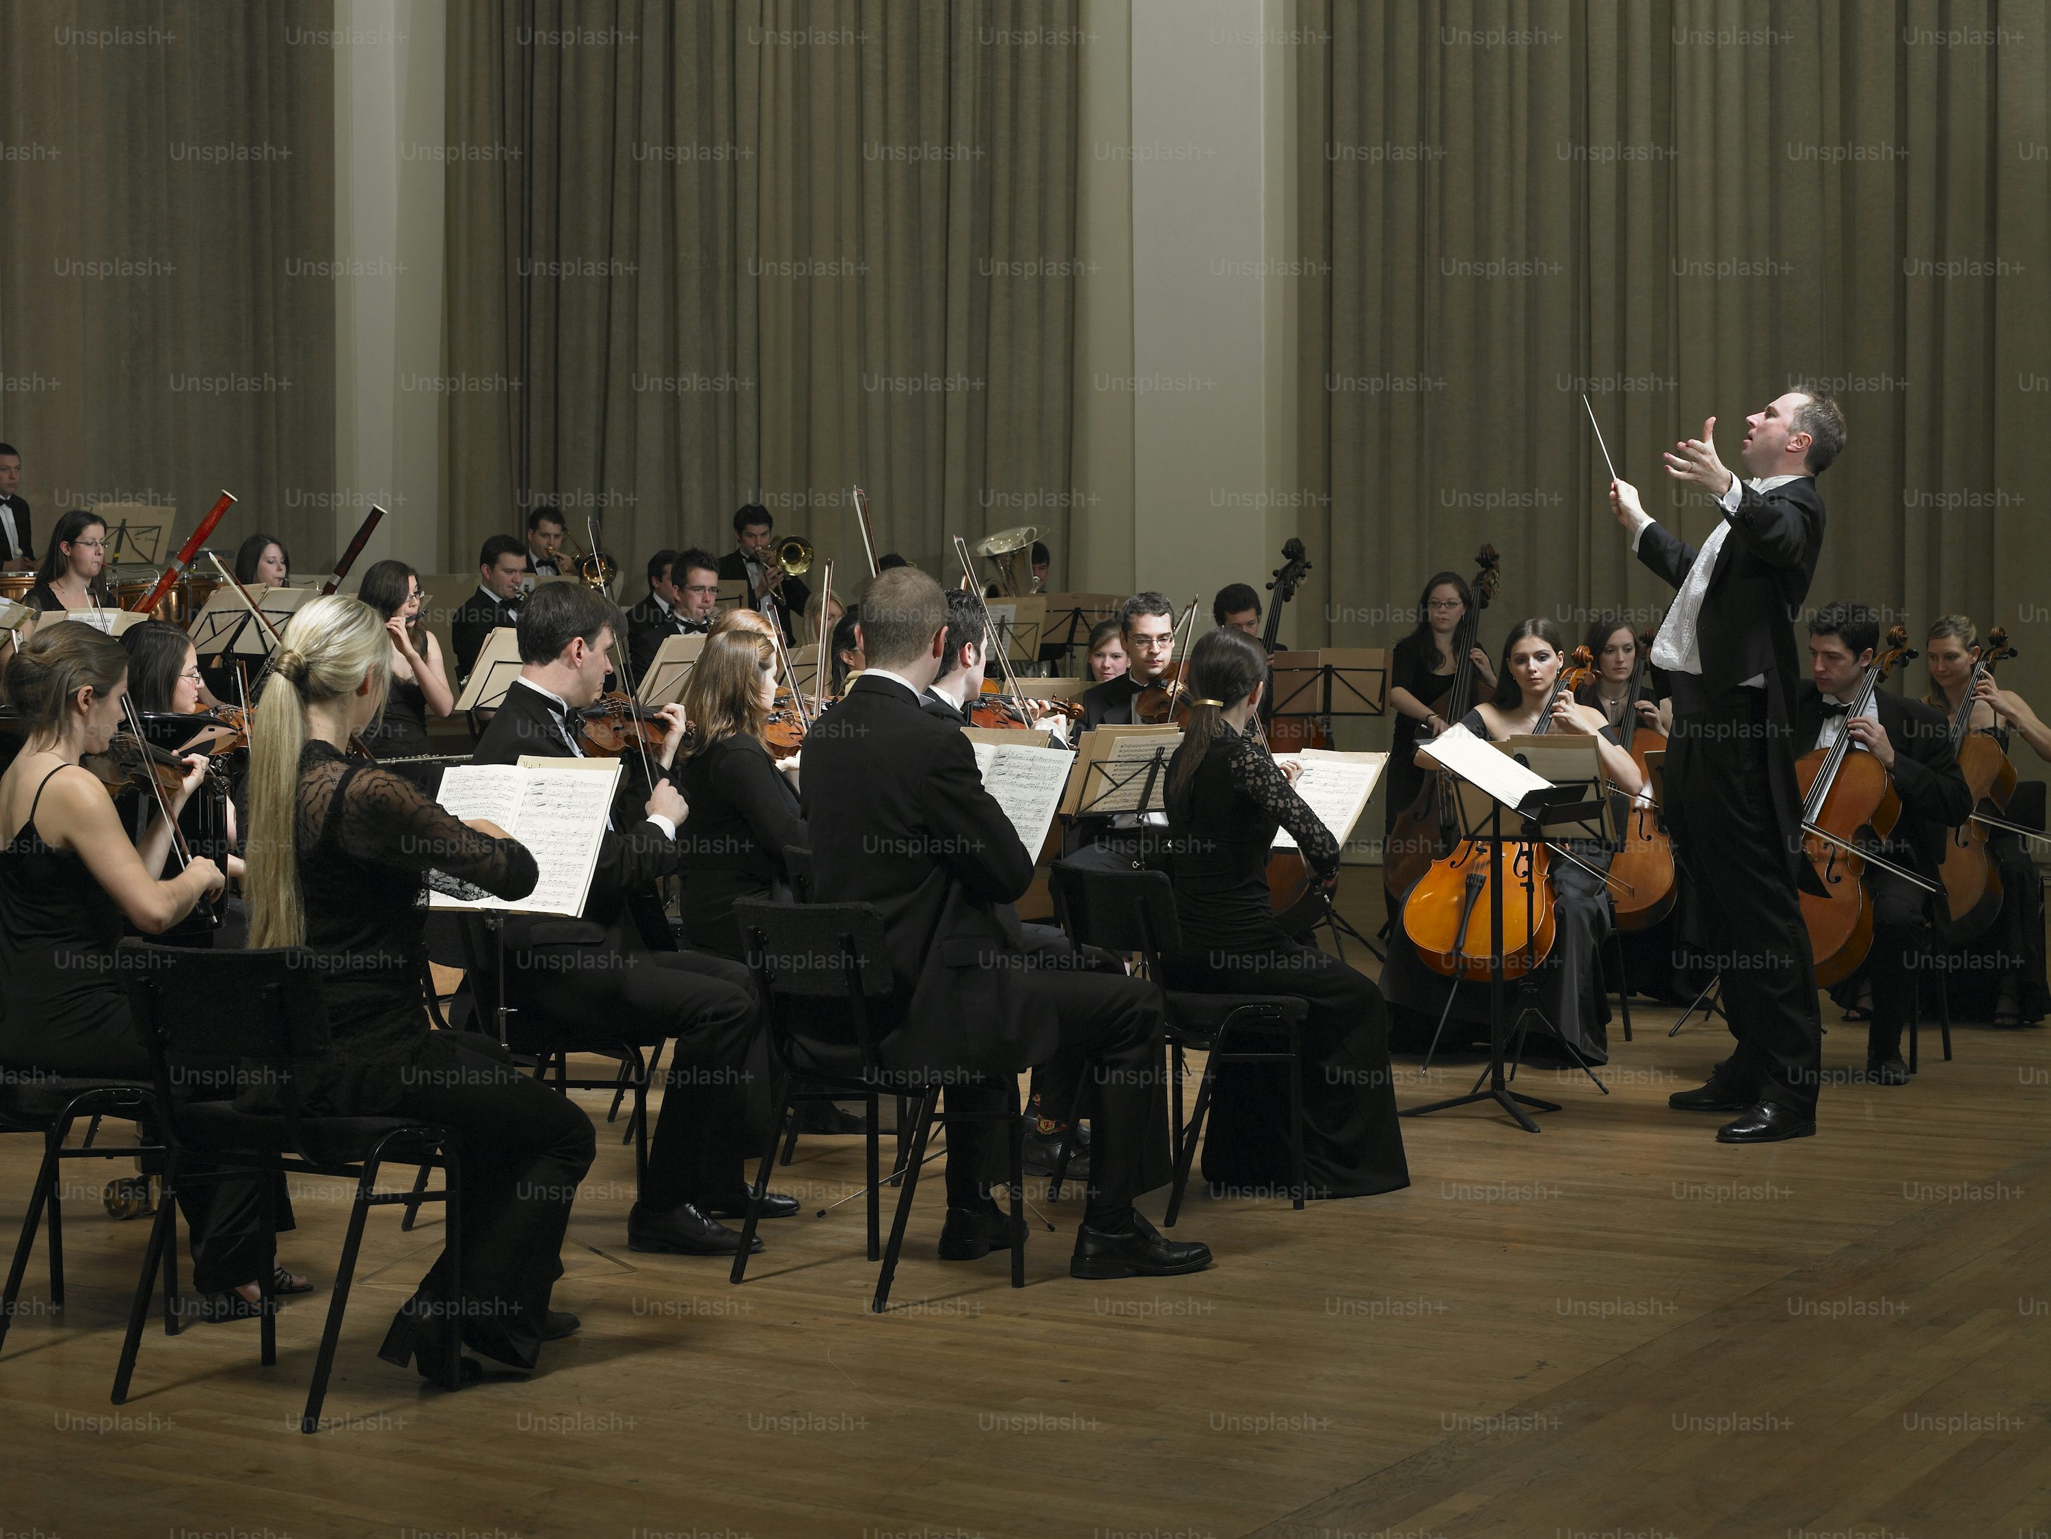
4.結果
ATTENTION
Notes:
https://unsplash.com/photos/a-conductor-and-orchestra-in-a-large-room-0HBPWHAspjs

Slide 7
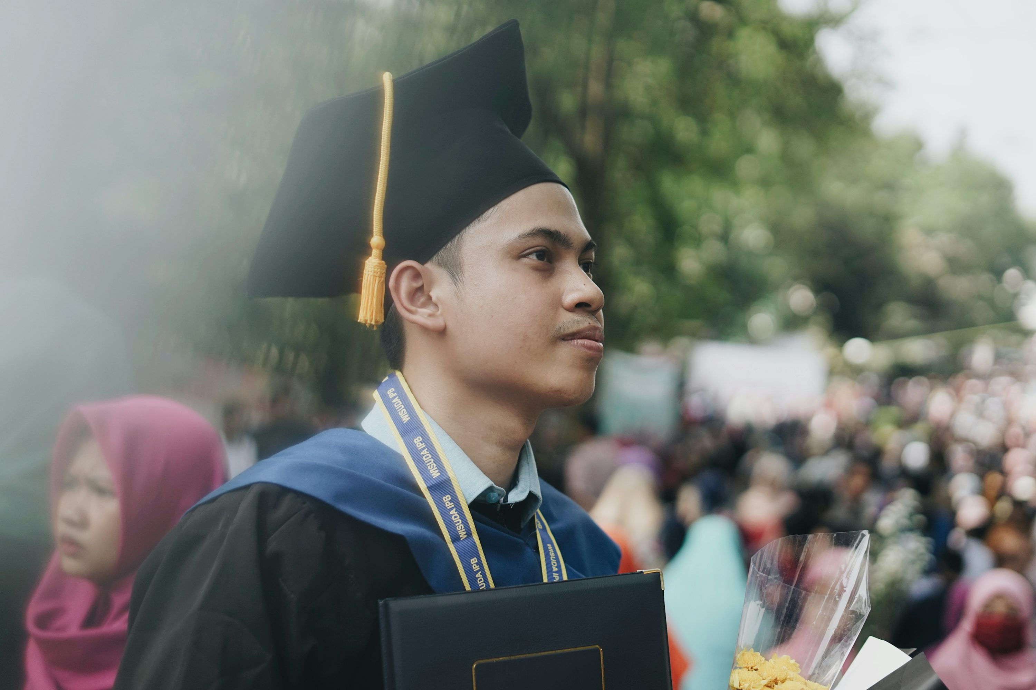
5.意外
ATTENTION
Notes:
https://unsplash.com/photos/man-wearing-mortar-board-EOaX5_9ea9k

Slide 8

6.轉彎
ATTENTION
Notes:
https://unsplash.com/photos/brown-and-white-flannel-shirt-w6uyEFvlakg

Slide 9
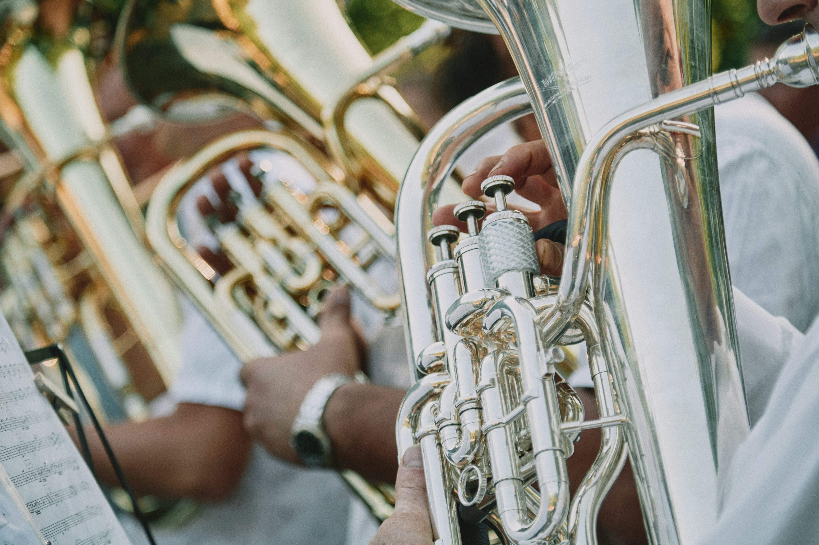
7.結局
ATTENTION
Notes:
https://unsplash.com/photos/person-playing-trumpet-during-daytime-PSthbAiIGks

Slide 10
非常事態
THE END

